Slide 1

React Components
Lesson 4 – Mr. Minh Sang

Slide 2
Objectives
How to create a React component
Use JSX to define the views of your component
Handling events
React components lifecycle

Slide 3

React Components Overview

Slide 4
React Components
A component returns a set of React elements that should appear on the screen
Components enable you to split your UI into independent, reusable pieces
Components also accept inputs
Different kinds of components can be defined in React

Slide 5
Exercise 6
React Components Part 1

Slide 6
React Components: State and Props

Slide 7
props
When React sees an element representing a user-defined component, it passes JSX attributes and children to this component as a single object. We call this object “props”.
Cannot modify props within the component
Props are Read-Only
Examples:
function Welcome(props) {
return <h1>Hello, {props.name}</h1>;
}
const element = <Welcome name="Sara" />;

Slide 8
State
Each component can store its own local information in its “state”
Private and fully controlled by the component
Can be passed as props to children
Only class components can have local state

Slide 9
state
State should only be modified using setState()
onPlayerSelect(player) {
this.setState({
selectedPlayer: player
});
}
Never do the following:
this.state.selectedPlayer = player;
State declared within the constructor:
class Main extends Component {
constructor(props) {
super(props);
this.state = {
players: Players
}
}
. . .
}

Slide 10
Lifting State Up
Sometimes several components may share the same data
Changes to data in one component needs to be reflected to another component
Best to move the shared state to a common ancestor component

Slide 11
Lists and Keys
Lists are handled similar to JavaScript
Example:
return (
<div className='container'>
{players.map((player)=>
(<h3>{player.name}</h3>
))}
</div>)
Keys should be given to elements inside the array
– Help identify which items have changed, are added or removed

Slide 12
Handling Events
Handling events is similar to the way you handle events on DOM elements:
Use camelCase to specify events
Pass function as the event handler
Example:
<button onClick={activateLasers}>
Activate Lasers
</button>

Slide 13
Exercise 7: React Components Part 2
Make use of the component to display a list of items.
Use Lists and Keys for Component .

Slide 14
React Component Types: Presentational and Container Components

Slide 15
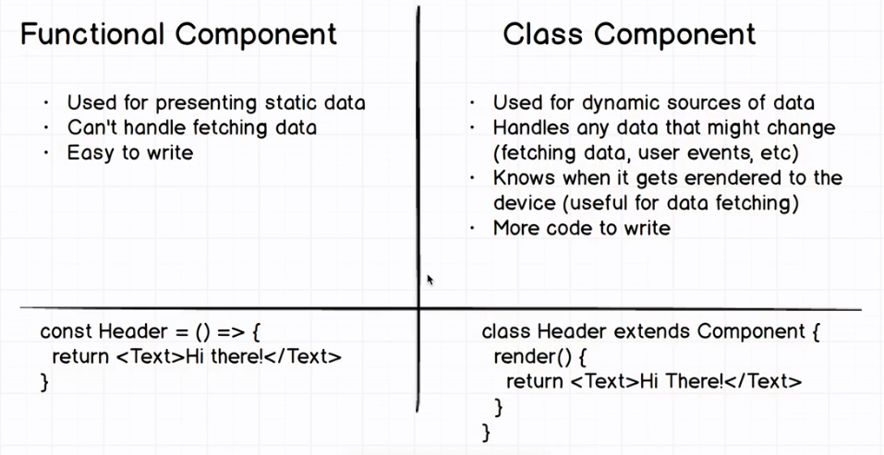
Types of react components

Slide 16
Exercise 8: Functional Components
Implement functional components in React
Illustrate the reimplementation of presentational components as pure functional components

Slide 17
Presentational components
// presentational component
…
{players.map((player)=>(
<h3>{player.name}</h3>
))}
…
Mainly concerned with how things look.
Have no major dependencies on the rest of the app.
No connection with the specification of the data that is outside the component.
Mainly receives data and callbacks exclusively via props.
May contain both presentational and container components inside it considering the fact that it contains DOM markup and styles of their own.

Slide 18
Container components
// container component
export class Main extends Component {
constructor() {
super();
this.state = {
players: Players
};}
render() {
return <PlayersPresentation players={this.state.players}/>
}
}
Mainly concerned with how things work.
May contain both presentational and container component but does not have DOM and markup of their own.
Provide the data and behaviour to presentational or other container components.
Call flux actions and provides these as callbacks to the presentational component.

Slide 19
Exercise 9: Presentational and Container Components
Organizing your React app into presentational and container components
Enable your presentational components to be concerned with the look and feel of your app
Enable container components to deal with the state, provide the data and handle user interactions.

Slide 20
React Components: Lifecycle Methods

Slide 21
React Component Lifecycle
React Component goes through the following lifecycle stages:
Mounting
Updating
Unmounting
Several lifecycle methods available in each stage

Slide 22
Mounting Lifecycle Methods
Called when an instance of a component is being created and inserted into the DOM:
constructor()
getDerivedStateFromProps()
render()
componentDidMount()
An earlier method now deprecated called componentWillMount()

Slide 23
Updating Lifecycle Methods
Called when a component is being re-rendered
Can be caused by changes to props or state
getDerivedStateFromProps()
shouldComponentUpdate()
render()
getSnapshotBeforeUpdate()
componentDidUpdate()
Two methods that are now deprecated: componentWillReceiveProps() and componentWillUpdate()

Slide 24
Unmounting Lifecycle Methods
Is called when the component is being removed from the DOM:
componentWillUnmount()
Error Handling: called when there is an error during rendering, in a lifecycle method or in the constructor of any child component
componentDidCatch()

Slide 25
Summary
How to create a React component
Use JSX to define the views of your component
React State and Props to passing data between components
React components types: Presentational and Container Components
Identify the salient features and uses for the various types of components
Create presentational, container and functional components in your React application
Handling events
React components lifecycle

